Slide 1
Renaissance “the rebirth”
1350-1600
Chapter 16

Slide 2
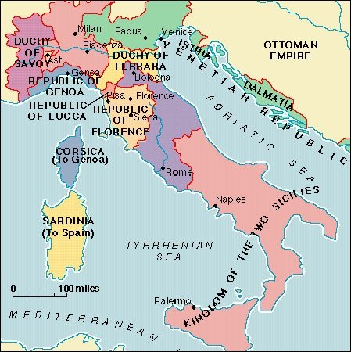
Spirit of the Renaissance
1300s saw economic distress, war and the Black Death
Renaissance began in city-states of Northern Italy

Slide 3
Italian city-states had grown wealthy from trade and industry.
Italian bankers made large profits by financing commercial ventures and making loans to princes and popes. The wealth of the city-states supported the Renaissance.
The concerns of the wealthy middle class helped shape the Renaissance in Italy. The middle class was concerned about education and individual achievement. They had the time and money to become patrons, or supporters, of the arts.

Slide 4
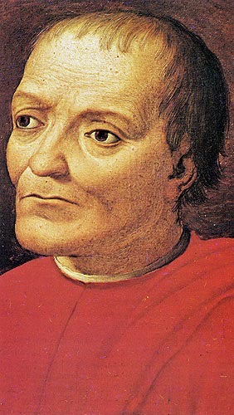
During the 1400s, the Medici family ruled Florence (organized a bank). The family expanded as far as London. They also controlled the government of Florence.
The Medici family came to symbolize the creative spirit of the Renaissance and were able to support the Renaissance movement economically.
Giovanni di Medici, 1360-1425 (65)
Founder of the Medici Bank

Slide 5
Study of Humanities
There was a renewed interest in education, especially the learning of ancient Greece & Rome.
During the Renaissance, scholars also stressed the studia humanitatis – the study of humanities.
Subjects included: grammar, rhetoric (the art of studying language), poetry, history.
Those who studied these subjects were called humanists.
Renaissance humanists were practical people. They wanted to learn more about the world.
By reading ancient texts, they rediscovered knowledge that had been lost or forgotten during the Middle Ages.
Many Renaissance humanists were devout Christians. They felt that the study of humanities enriched their lives as Christians.
Renaissance scholars thought education was the way to become a well-rounded individual.

Slide 6
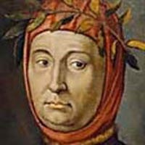
Recovering the Classics
Francesco Petrarch (1304-1374) was an early
Renaissance humanist from Florence.
Petrarch began to realize how much of the classical heritage had been lost. His work encouraged others to recover writings of the classical world. They searched for manuscripts in monastery libraries.
A visitor to one monastery library discovered that only the walls remained standing. There was no door or roof. A thick layer of dust covered everything and grass grew on the window sills. The manuscripts lay in disorganized piles.
The scholars wanted to restore the classics to their original form. Therefore, they compared copies of the same work to discover where mistakes had been made when it was recopied.

Slide 7
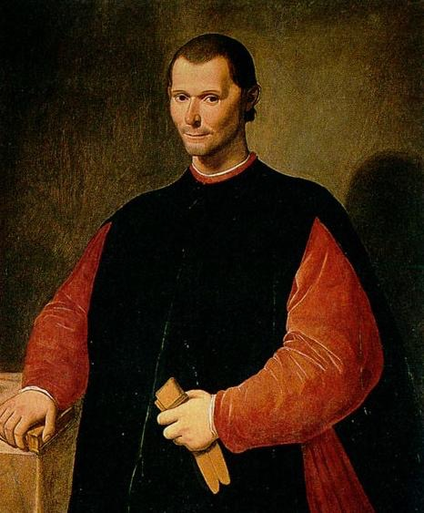
Handbooks for Proper Behaviour
Renaissance writers often prepared manuals that told individuals how to behave.
They encouraged attendants to cultivate their talents such as learning to play a variety of instruments and to appreciate music as an ideal Renaissance person was someone who had a broad education in many different areas.
One well-known manual was The Prince by Nicolo Machiavelli (1469-1527). This manual was written as a handbook for rulers of the Italian city-states, who often faced unstable political conditions.
Machiavelli cautioned, “It is much safer to be feared than to be loved, if one must choose.” He taught that “the end justifies the means.”
Morally wrong actions are sometimes necessary to achieve morally right outcomes.

Slide 8
The Renaissance in Northern Europe
In Northern Europe & Spain, the Renaissance took a different form. For one thing, feudalism, with its traditions of knighthood and chivalry, was stronger in northern Europe than in Italy. Therefore, kings , queens & nobles, rather than merchants and bankers were the chief patrons of the arts.
Renaissance scholars in northern Europe & Spain took a more traditional approach to religion than some Italian humanists. They studied classical works but more likely to study the writings of early Christians than of Greeks and Romans.
Northern European humanists devoted their time to uncovering what they believed was the simpler, purer faith of the early Christians.
People during the Renaissance were more concerned with achieving worldly success. Yet they maintained a strong faith in Christianity.

Slide 9
Art & Literature of the Renaissance
During the Middle Ages, painters and sculptors decorated many churches and cathedrals but they received little individual recognition for their work. As a result, the names of only a few medieval artists are known today.
In contrast, dozens of Renaissance artists are well known today. Popes, rulers, merchants, and bankers competed for their services.
Renaissance artists proudly accepted the fame that their creative genius brought.

Slide 10
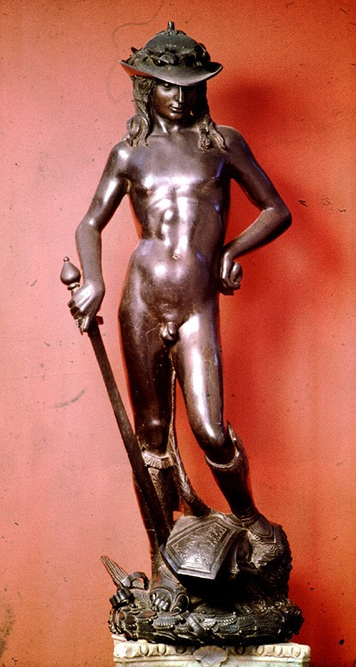
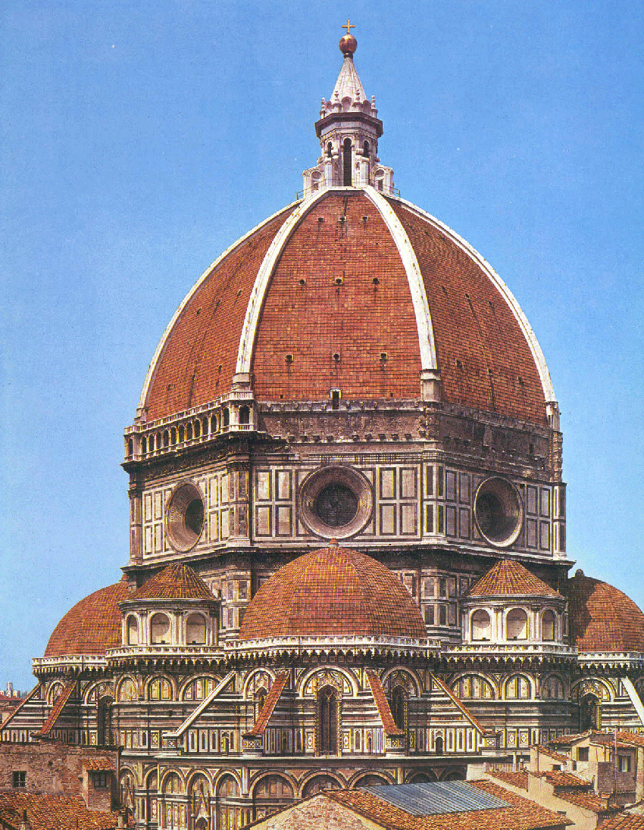
Classical Influence
Two noted artists are the sculptor Donatello and the architect Filippo Brunelleschi.
Donatello (1386-1466) created the statue of David, a king of the ancient Hebrews. David stood alone, free to be admired from all sides – he was portrayed with realism and grace.
Brunelleschi (1377-1446) and other Renaissance architects rejected medieval gothic architecture and revived classical styles. They designed elegant buildings, using columns and domes.
Brunelleschi created a sensation when he proposed to top the unfinished cathedral in Florence with a vast dome. Many people thought the building would collapse.

Slide 11
New Techniques In Art
Artists tried to show the world realistically, as it actually existed.
They developed rules of perspective to give paintings an even more realistic look. The rules enabled artists to paint scenes so that they appeared to be three dimensional. For example, to give a sense of depth or distance in a scene, figures closer to the viewer were drawn larger. Those further off were drawn smaller.

Slide 12
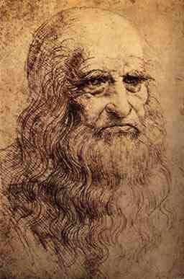
Great Italian Artists
Leonardo da Vinci (1452-1519) – was fascinated by flight, he observed birds on the wing. In his notebooks he showed how he thought humans might use wings to fly. In order to understand the anatomy of the human body, he dissected corpses. He then used his knowledge to paint more realistic figures.
Sadly, much of Leonardo’s work has been lost. Only 15 of his paintings survive.

Slide 13
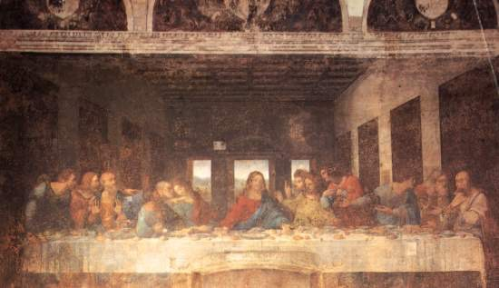
Da Vinci – The Last Supper

Slide 14
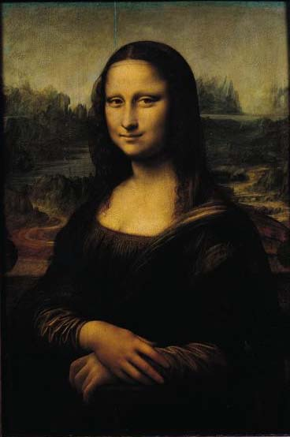
Da Vinci – Mona Lisa
One of the most famous works of art in the world – a portrait of Lisa della Giaconda, wife of a Florentine merchant.

Slide 15
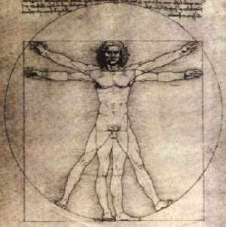
Da Vinci – The Vitruvian Man

Slide 16
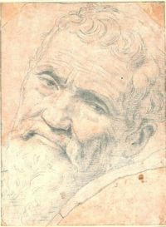
Michelangelo (1475-1564) – In 1508, Pope Julius II asked Michelangelo to paint the ceiling of the Sistine Chapel in the Vatican, the pope’s palace in Rome.
Michelangelo devoted four years to the task. For hours each day he lay on his back atop a high scaffold and painted scenes from the Bible such as God creating the world, Noah and the flood, and Christ’s crucifixion.

Slide 17
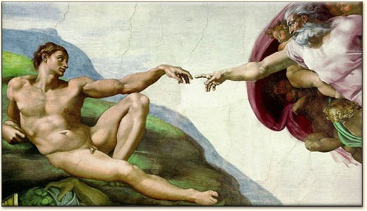
Michelangelo – Sistine Chapel

Slide 18
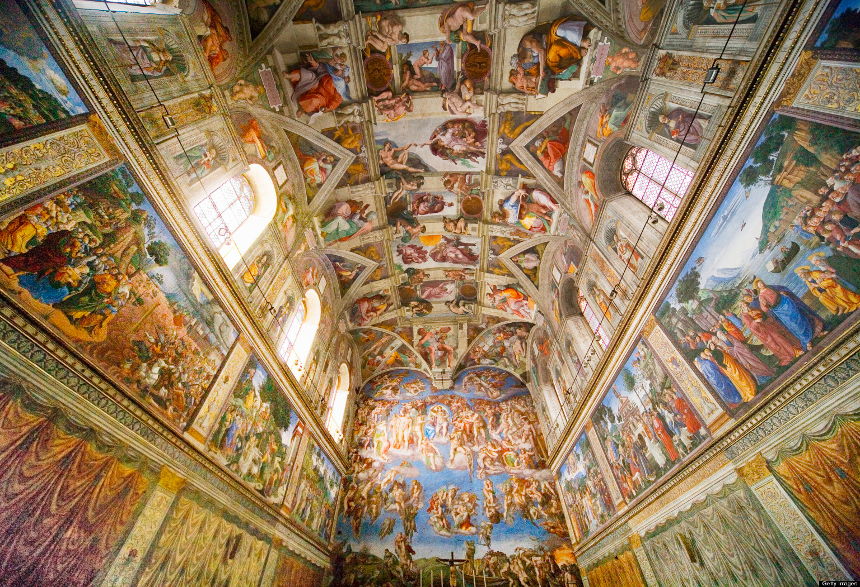

Slide 19
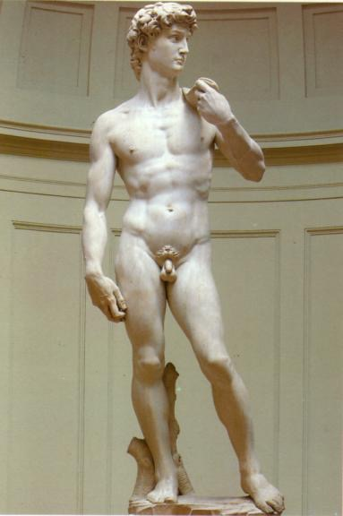
Michelangelo - The Statue of David

Slide 20
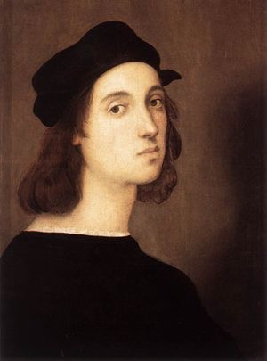
Raphael (1483-1520) – Raphael favored the bright colors traditionally used by painters from the Umbria region of Italy.
He often painted the Madonna, or Mother of Jesus, and the infant Jesus.

Slide 21
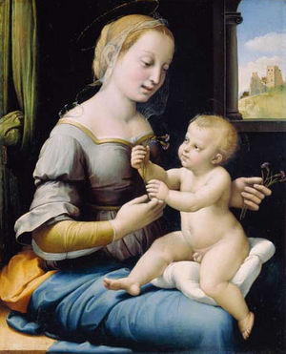
Raphael – Madonna of the Pinks

Slide 22
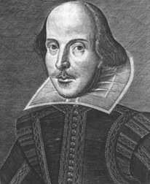
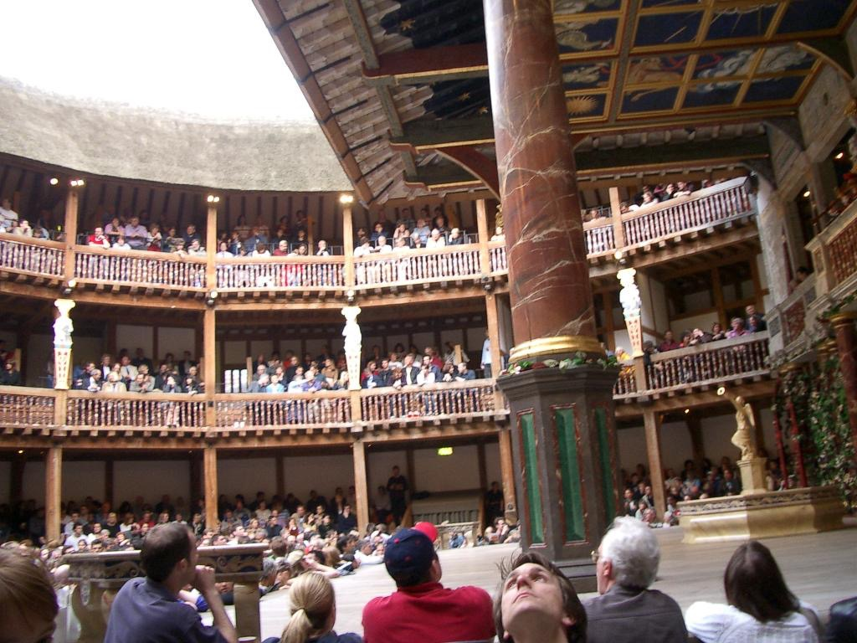
Renaissance Writers
Popular literature was often written in vernacular (native language) although many Renaissance writers continued to write in Latin.
One of the most famous is William Shakespeare

Slide 23
Humanism
Renaissance humanists (artists and writers) were all religious.
Humanism is a balance between intellectual reason and religious faith.
Artists and writers depicted people in real life situations

Slide 24
Medieval thought (before 1300)
It was the Age of Faith.
People were very religious. Period. Point blank.
Man is, by nature, bad.
The world is a bad place.
Man should spend his time trying to get into heaven.
The slogan: “We care about the masses getting into Heaven.”

Slide 25
Renaissance thought (after 1300)
Renaissance humanists (artists and writers) were all religious.
Humanism was a balance between intellectual reason and religious faith.
Man is capable of doing good.
The world is where we live - so let’s deal with it.
Man should spend his time well in this world.
The slogan: “We care about the individual in this world.”

Slide 26
What is the meaning of life?
1. We stress the importance of human beings.
2. We stress the importance of God.

Slide 27
What is the world?
3. Society is wicked.
4. Society can civilize people.
5. Society is full of evil temptations.
6. You have a responsibility and a duty to the society in which you live.
7. You should care about life on earth.
8. You should care about life after death.
9. You should despise this world.
10. Concentrate on getting into heaven.

Slide 28
What is the nature of man(woman)?
11. People are, by nature, sinners.
12. People are capable of doing good.
13. Man is basically good.
14. Man is basically bad.

Slide 29
How should you spend your time?
15. Pray to God and save your soul.
16. Create paintings, sculptures, books that elevate man.

Slide 30
Who is your model of ideal behavior?
17. Study the lives of saints.
18. Study the accomplishments of great men who lived during the ancient civilizations.
19. Scholars should study the Bible to understand the mysteries of God’s will.
20. Scholars should study subjects (literature and philosophy) that will help them

Slide 31
Changing Patterns of Life
Advanced technology gradually helped spread the new learning to a wider audience. As a result, Renaissance learning slowly filtered into the lives of ordinary people.

Slide 32
The Introduction of Printing
The invention of printing in the 1400s dramatically affected the production of books. Before this time, few books were reproduced because each one had to be copied by hand. A good copier could complete only about two books a year. Furthermore, books were costly because they were written on parchment made from skin of a sheep or goat.
In the 1300s, Europeans learned from the Arabs how to make paper from rag and wood pulp. The Arabs had learned about papermaking from the Chinese.
Engravers experimented with printing books from wood blocks. They carved a page on the block, which was then inked and pressed on paper. By the 1440s, German engravers had developed movable type. Movable type consisted of tiny pieces of metal engraved with a letter.

Slide 33
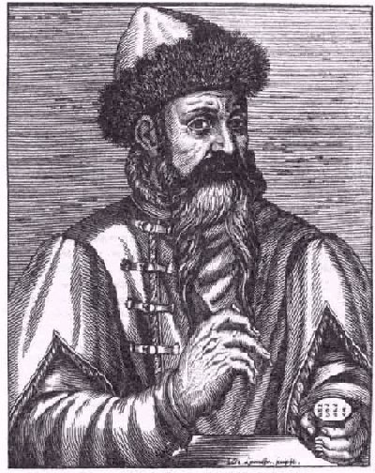
Johann Gutenberg (1398-1468)
In 1455, he used his invention – the printing press - to print a complete edition of the Bible. With the Gutenberg Bible, as it was called, the era of printed books began.
As printing methods improved, the cost of producing books fell.
The use of paper and the development of printing had a revolutionary impact on the world of learning. Books could be produced more quickly and less expensively than before.
Many of the newly printed books were religious works such as the Bible and biographies of saints.
The availability of books on the sciences and technology would greatly affect the Scientific Revolution.

Slide 34
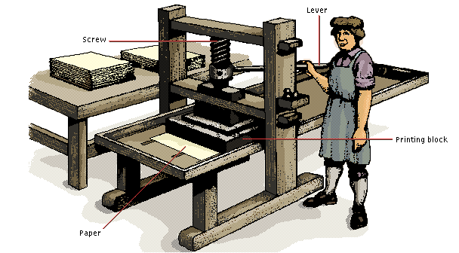
Gutenberg Printing Press

Slide 35
Everyday Life
Nuclear family emerged during the Renaissance. Only parents and their children lived in a household.
Some people formed business partnerships with people outside the family. Two or more families might pool their resources in order to expand business activities.

Slide 36
The Black Death had greatly reduced the population of Europe.
Thus, the demand for wheat and other grains fell. Farmers began producing new types of food, which they hoped would be more profitable. The new foods included meat, fruit, and dairy products such as cheese and butter. People’s diets changed.
The demand for wool cloth increased when the population throughout Europe began to grow again. Wool workers then found their skills in much demand, and they asked for higher wages.

Slide 37
Women in the Renaissance
Their main responsibilities remained in the home, where they raised the children and took care of the family. Farm women and children worked in the fields alongside the men.
However, women also worked outside the home. Some women were employed as servants in households of wealthy farmers, merchants, or nobles. Many women also earned money as spinners and weavers, although most workers in the cloth industry were men.
As the number of schools increased, more women learned to read and write.

