Slide 1
Ancient Hopi Civilization
Mrs. Fishley

Slide 2
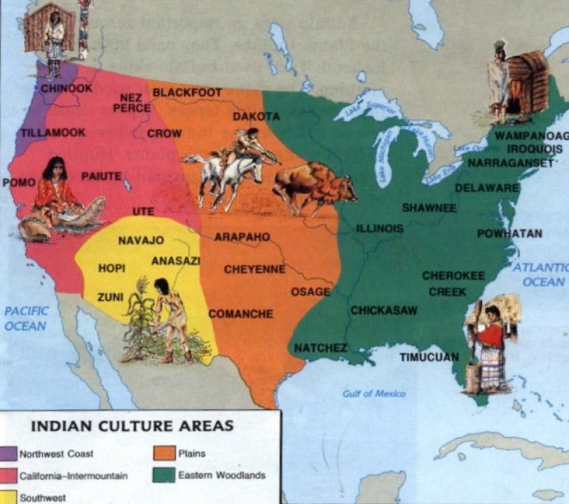

Slide 3
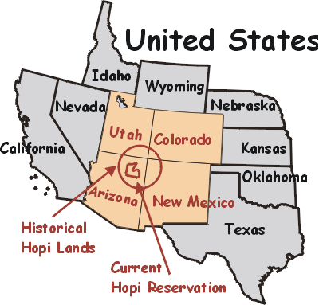
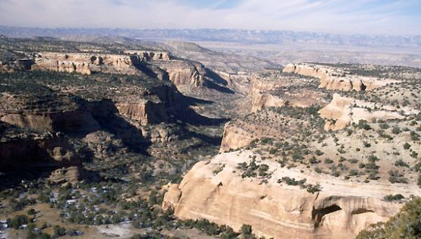
How Their Geography and Climate Affected Their Movement Patterns
This civilization developed in the Southwest of the United States.
The area is dry, with little rainfall, so water was a very important resource.
They were not nomadic, but did travel along the Colorado River to trade with other tribes.
Their winters were cool with snow, and their summers were hot and dry.
The geography of this area is sandy and rocky, with high mesas and few trees except in the river valleys.
Because of their climate and geography, they were able to build permanent residences, and didn’t move around a lot. When they did move, the river provided a method of transportation.

Slide 4
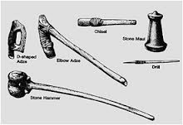
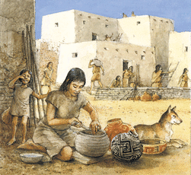
How Their Geography and Climate Affected Their Technology
Their technology had to do mostly with farming.
Because water was such a precious resource, collecting and storing water was a priority.
They channeled water into cisterns.
They channeled water into the fields using dams.
They grew crops in the flood plain to maximize water usage.
They also developed irrigation methods to maximize water usage.
They created dams using stones or brush and sand.
They used digging sticks to create channels for water.

Slide 5
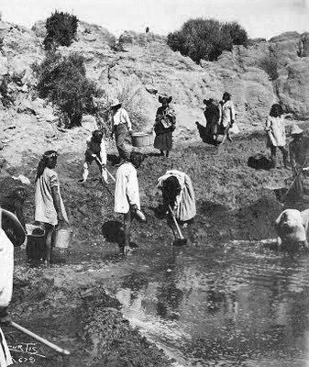
How They Affected Their Environment
They built cities in river valleys using mud and stone bricks.
They hollowed out rocks to be used as cisterns. (Some of them are still holding water today.)
They altered the flood plain to create irrigation by digging channels and creating dams.
They had basic mining of metals such as silver.
They hunted and fished, using all parts of the animal and letting none of it go to waste.
Although they moved to a different area because of climate change, it was not brought about because of their culture.

Slide 6
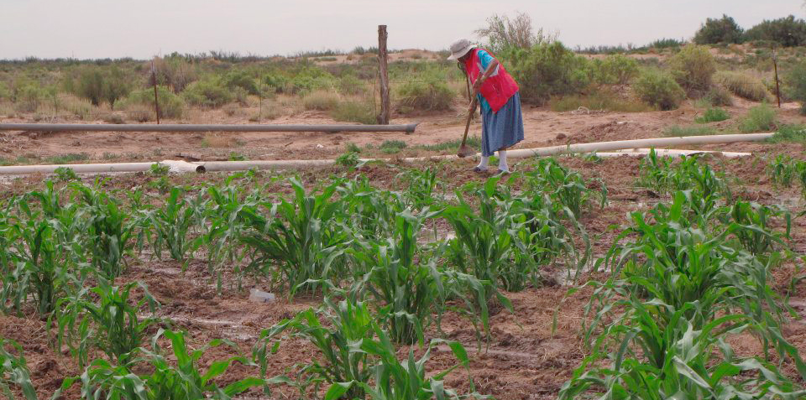
Agriculture & Hunting
They animals in this area included large animals such as deer, as well as small animals such as rodents and rabbits. The Hopi hunted these animals with bow and arrows, nets, and snares.
They would also use corrals and pits to herd animals into a small area for easy killing.
Wild turkeys were domesticated, and the Hopi people used these to supplement their hunting.
They farmed maize (a type of corn), beans, chili peppers, onions, pumpkins, and sunflowers, and dried some to be stored for seed and in case of crop failure in the following year.

Slide 7
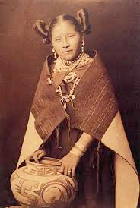
Their Government
They governed with a matrilineal system, which means that the women were in charge, and relationships were followed through the mother’s line.
Each pueblo, which was a group of families or clans, had a group of elder women who made decisions on behalf of the pueblo.
They were known as the “peaceful ones” in the Southwest, and rarely fought against other tribes or pueblos, but would fiercely protect their people and property if threatened.

Slide 8
Laws and How They Were Enforced
The women made the decisions as they were the ones who were home.
Rarely did people go against what was considered acceptable behaviour.
If people did go against the social order, the adults in the clan decided their punishment, the most severe of which was banishment or ostracism.
The Hopi people considered it wrong to lie, steal, or be unfaithful to your spouse.

Slide 9
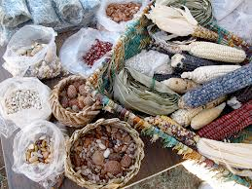
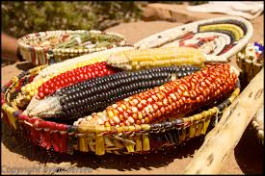
Resources & Trade
The Hopi obtained gems and shells from other tribes.
They traded for sheep and wool, as well as buckskins.
The Hopi would trade silver and hides from other animals, as well as surplus food.
They made pottery and wove blankets which were also used as trade items.
Jewelry was also used as a trade item.

Slide 10
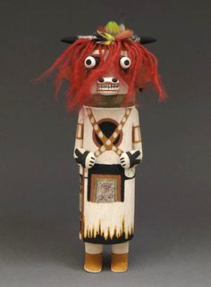
Religion & Spirituality
The Hopi did not have a shaman figure, but did have priests used to communicate with the gods.
There were several gods that they worshipped, most of which were associated with farming and fertility.
Ceremonies took place in a kiva, which was a circular room built mostly underground. Within the room was a sipapu, which was a symbolic spot built to symbolize where human beings entered the world.
Kachinas were small dolls built to represent the supernatural.

Slide 11
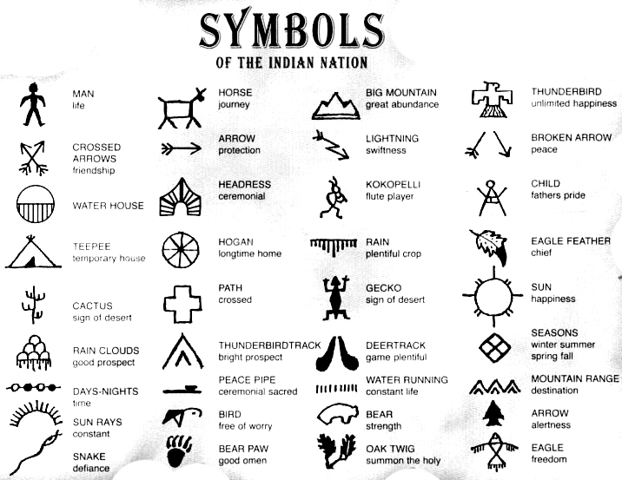
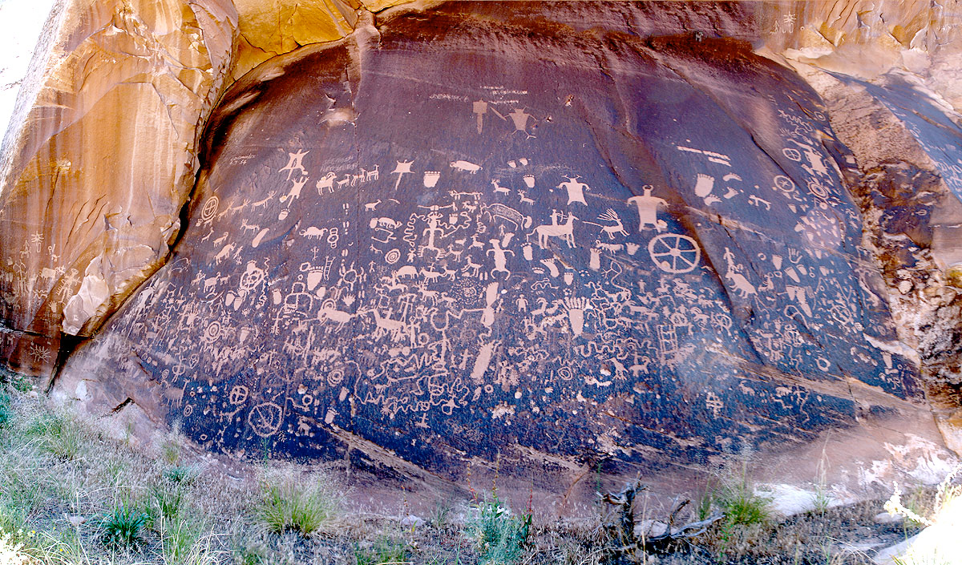
Written Records
The Hopi people did not have a written language.
Stories and traditions were passed down orally from elders to the young people.
They did use symbols to communicate with other clans and tribes. These were left on rocks so that others could see them.
Maybe the most famous example is Newspaper Rock near Moab, Arizona.
From their petroglyphs we can tell that they valued animals, and that they held certain animals as sacred. When the Europeans arrived, the petroglyphs changed to show this new facet of their world.

Slide 12
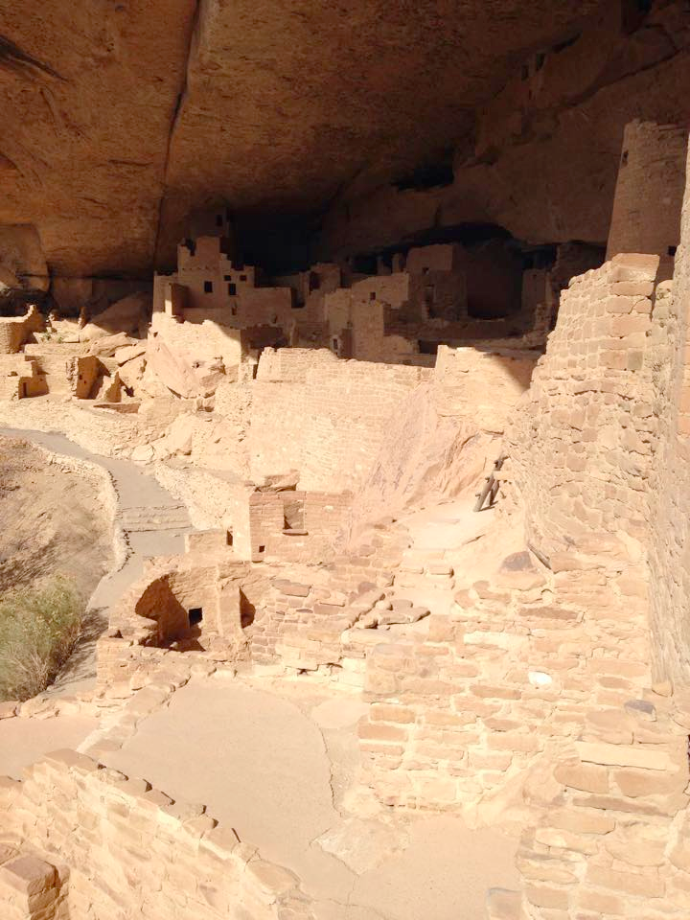
Architecture
Houses were made from mud and stone with roof beams of pine and juniper.
The house was entered through an opening in the roof using a ladder.
The houses were all built around a central plaza, and was built in levels.
There was always at least one kiva built in each community, sometimes there was one big one and several smaller ones.
From their cities, we can tell that they valued family and community, and that they had a religion because kiva’s were central to the city.

Slide 13
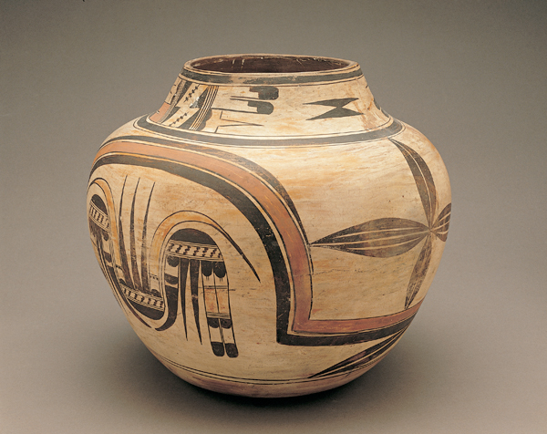
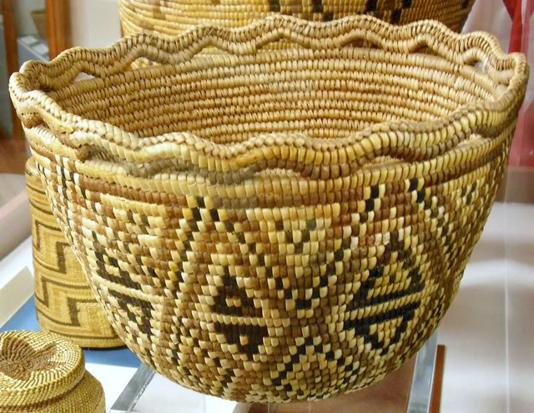
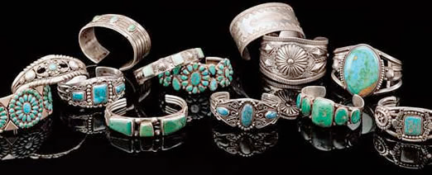
The Arts
The Hopi people made jewelry, pottery, and textiles.
These served several purposes:
They were decorative
They were functional
They were often used to tell stories or keep records
They valued beauty enough to make their everyday items beautiful.
Their artwork also shows us that their worldview included religion, and that their oral history was important.

Slide 14
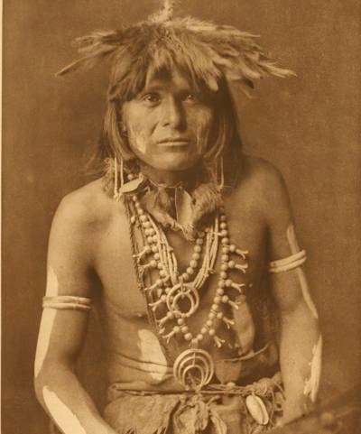
Education
There was no written language, only pictographs, so children learned their history orally.
Elders taught children through various cultural traditions such as pottery, weaving, stories, and celebrations.

Slide 15
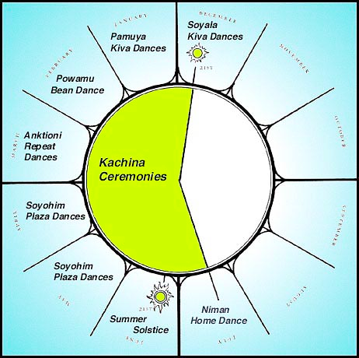
Celebrations
There are two main ceremonies.
The winter solstice ceremony was the most important, and involved masks and dancing.
Both main ceremonies lasted nine days.
There were several other ceremonies throughout the year, but they were less important.

Slide 16
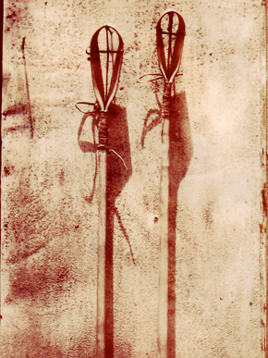
Recreation
Younger children, particularly girls, would play with dolls similar to kachina dolls.
Their main sport was stickball, which is similar to lacrosse or field hockey.

Slide 17
Worldview
For the Hopi people, the gods and nature/farming are the two most important things, therefore, their worldview centres around those two things.
Everything they do contributes to either their spirituality or the farming and getting of food.
They valued nature, and respected their environment, considering the various aspects of nature to be represented by gods.
They believed that the gods taught them how to act, and provided for them if they showed the gods respect through the various ceremonies.
Their worldview was quite strong, and helped them to survive and resist the European conquerors for some time after many other tribes surrendered.
Their ability to survive in their climate and geography made them stronger.

Slide 18
Timeline of Hopi Culture
10 000 - 5000 BC
Evidence of primitive
settlements in the area.
50 AD
First pit
houses appear
450 BC
Beans are
domesticated
1100 - 1200 AD
Cliff dwellings flourish,
peak of Hopi civilization
4000 BC
Evidence of first
domesticated corn
300 AD
Pottery comes
to Four Corners
area
800 AD
First cliff
dwellings built
By 1300 all but the
very best cliff dwellings
were abandoned.

Slide 19
Works Cited
https://www.superteachertools.net/speedmatch/speedmatchfromj.php?gamefile=1410239749#.VcQVOEXe9hA
http://www.blm.gov/wo/st/en/prog/more/Landscape_Approach/reas/coloplateau.html
http://www.everyculture.com/multi/Ha-La/Hopis.html
http://nativejewelrylit.com/hopi-history.html
http://cpluhna.nau.edu/Research/hack.htm
http://www.jeffposey.net/anasazi-timeline/
http://class.csueastbay.edu/anthropologymuseum/virtmus/Southwest/kachina/calenderpage.html
http://nativeamerican-art.com/hopi-legends.html

