Slide 1
Your Culture
Your Name

Slide 2
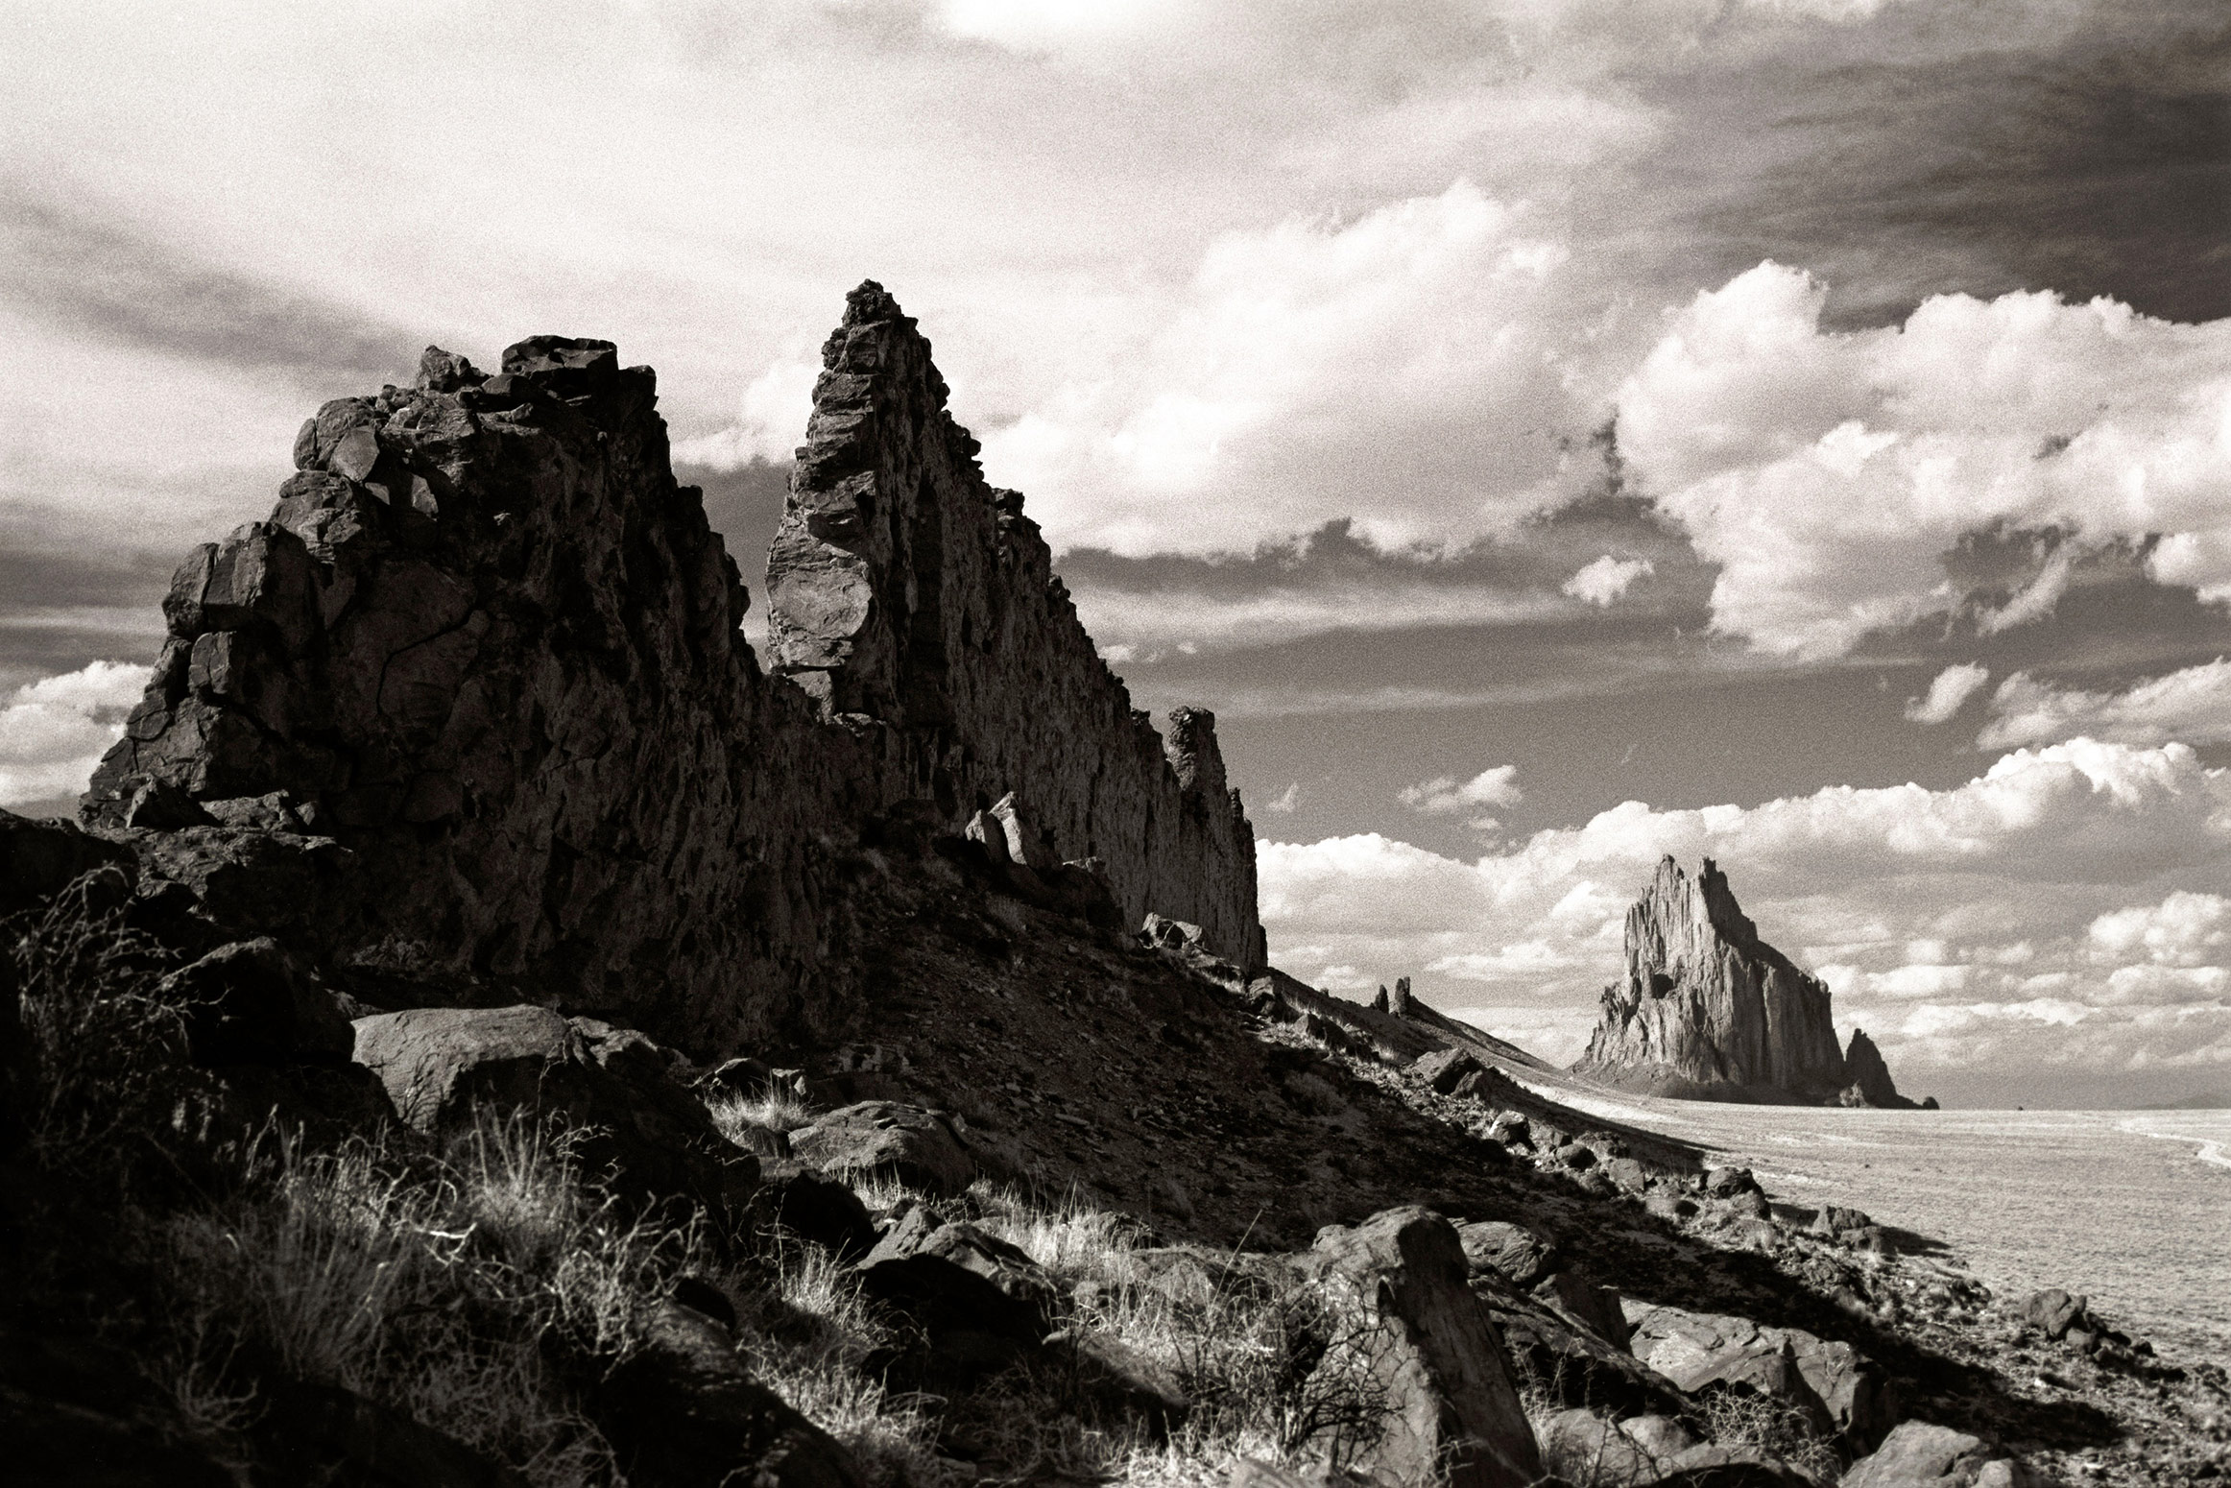

Slide 3
How Their Geography and Climate Affected Their Movement Patterns

Slide 4
How Their Geography and Climate Affected Their Technology

Slide 5
How They Affected Their Environment

Slide 6
Their Government

Slide 7
Laws and How They Were Enforced

Slide 8
Resources & Trade

Slide 9
Religion & Spirituality

Slide 10
Written Records

Slide 11
Architecture

Slide 12
The Arts

Slide 13
Education

Slide 14
Celebrations

Slide 15
Recreation

Slide 16
Worldview

Slide 17
Timeline

Slide 18
Works Cited

